Slide 1
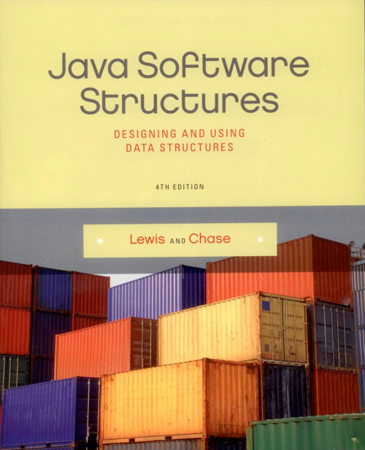
Chapter 3
Introduction to
Collections - Stacks

Slide 2
Chapter Scope
Collection terminology
The Java Collections API
Abstract nature of collections
Stacks
Conceptually
Used to solve problems
Implementation using arrays

Slide 3
Collections
A collection is an object that holds and organizes other objects
It provides operations for accessing and managing its elements
Many standard collections have been defined over time
Some collections are linear in nature, others are non-linear

Slide 4
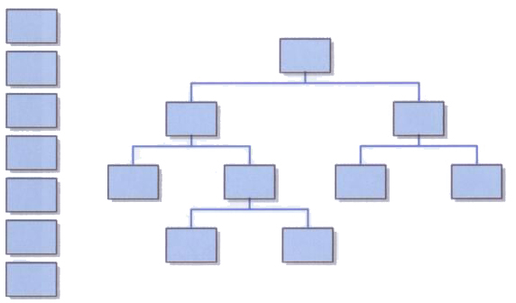
Linear and Non-Linear Collections

Slide 5
Abstraction
An abstraction hides details to make a concept easier to manage
All objects are abstractions in that they provide well-defined operations (the interface)
They hide (encapsulate) the object's data and the implementation of the operations
An object is a great mechanism for implementing a collection

Slide 6
Abstract Data Type
A data type is a group of values and the operations defined on those values
An abstract data type (ADT) is a data type that isn't pre-defined in the programming language
A data structure is the set of programming constructs and techniques used to implement a collection
The distinction between the terms ADT, data structure, and collection is sometimes blurred in casual use

Slide 7
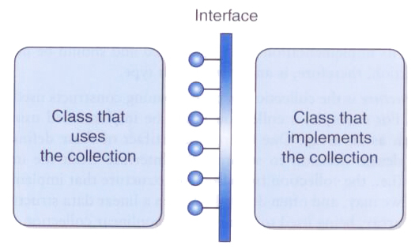
Collection Abstraction
A class that uses a collection interacts with it through a particular interface

Slide 8
The Java Collections API
As you know, the various classes provided with Java are referred to as the Java API (application programmer interface)
The subset of those classes that support collections is called the Java Collections API
As we explore a particular collection, we will also examine any support provided in the Collections API for that collection

Slide 9
Stacks
A stack is a classic collection used to help solve many types of problems
A stack is a linear collection whose elements are added in a last in, first out (LIFO) manner
That is, the last element to be put on a stack is the first one to be removed
Think of a stack of books, where you add and remove from the top, but can't reach into the middle

Slide 10
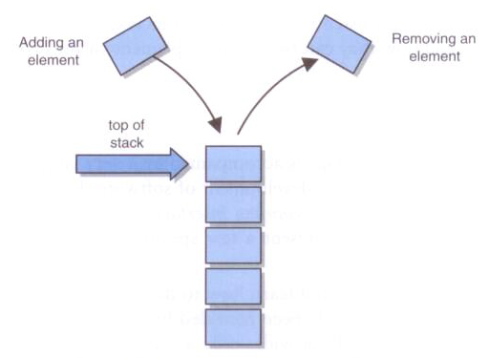
Stack - Conceptual View

Slide 11
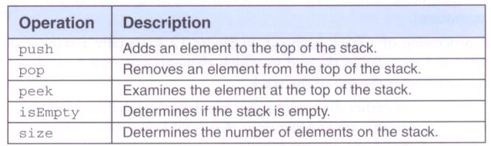
Stack Operations
Some collections use particular terms for their operations
These are the classic stack operations:

Slide 12
Object-Oriented Concepts
Several OO concepts, new and old, will be brought to bear as we explore collections
We'll rely on type compatibility rules, interfaces, inheritance, and polymorphism
Review these concepts as necessary
We'll also rely on a programming mechanism introduced in Java 5, generics, which are particularly appropriate for implementing collections

Slide 13
Generics
Suppose we define a stack that holds Object references, which would allow it to hold any object
But then we lose control over which types of elements are added to the stack, and we'd have to cast elements to their proper type when removed
A better solution is to define a class that is based on a generic type
The type is referred to generically in the class, and the specific type is specified only when an object of that class is created

Slide 14
Generics
The generic type placeholder is specified in angle brackets in the class header:
class Box<T>
{
// declarations and code that refer to T
}
Any identifier can be used, but T (for Type) or E (for element) have become standard practice

Slide 15
Generics
Then, when a Box is needed, it is instantiated with a specific class instead of T:
Box<Widget> box1 = new Box<Widget>();
Now, box1 can only hold Widget objects
The compiler will issue errors if we try to add a non-Widget to the box
And when an object is removed from the box, it is assumed to be a Widget

Slide 16
Generics
Using the same class, another object can be instantiated:
Box<Gadget> box2 = new Box<Gadget>();
The box2 object can only hold Gadget objects
Generics provide better type management control at compile-time and simplify the use of collection classes

Slide 17
Postfix Expressions
Let's see how a stack can be used to help us solve the problem of evaluating postfix expressions
A postfix expression is written with the operator following the two operands instead of between them:
15 8 -
is equivalent to the traditional (infix) expression
15 - 8
Also know as Reverse Polish Notation

Slide 18
Postfix Expressions
Postfix expressions eliminate the need for parentheses to specify the order of operations
The infix expression
(3 * 4 – (2 + 5)) * 4 / 2
is equivalent to the postfix expression
3 4 * 2 5 + – 4 * 2 /

Slide 19
Evaluating Postfix Expressions
We'll use a stack as follows to evaluate a postfix expression:
Scan the expression left to right
When an operand is encountered, push it on the stack
When an operator is encountered, pop the top two elements on the stack, perform the operation, then push the result on the stack
When the expression is exhausted, the value on the stack is the final result

Slide 20
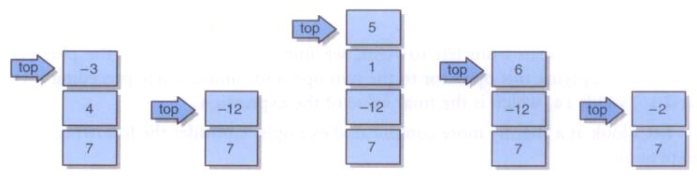
Evaluating Postfix Expressions
Here's how the stack changes as the following expression is evaluated:
7 4 -3 * 1 5 + / *

Slide 21
Postfix Expressions - Java

Slide 22
import java.util.Scanner;
/**
* Demonstrates the use of a stack to evaluate postfix expressions.
*
* @author Lewis and Chase
* @version 4.0
*/
public class PostfixTester
{
/**
* Reads and evaluates multiple postfix expressions.
*/
public static void main(String[] args)
{
String expression, again;
int result;
Scanner in = new Scanner(System.in);
do
{
PostfixEvaluator evaluator = new PostfixEvaluator();
System.out.println("Enter a valid post-fix expression one token " +
"at a time with a space between each token (e.g. 5 4 + 3 2 1 - + *)");
System.out.println("Each token must be an integer or an operator (+,-,*,/)");
expression = in.nextLine();
result = evaluator.evaluate(expression);
System.out.println();
System.out.println("That expression equals " + result);
System.out.print("Evaluate another expression [Y/N]? ");
again = in.nextLine();
System.out.println();
}
while (again.equalsIgnoreCase("y"));
}
}

Slide 23
import java.util.Stack;
import java.util.Scanner;
/**
* Represents an integer evaluator of postfix expressions. Assumes
* the operands are constants.
*
* @author Lewis and Chase
* @version 4.0
*/
public class PostfixEvaluator
{
private final static char ADD = '+';
private final static char SUBTRACT = '-';
private final static char MULTIPLY = '*';
private final static char DIVIDE = '/';
private Stack<Integer> stack;
/**
* Sets up this evalutor by creating a new stack.
*/
public PostfixEvaluator()
{
stack = new Stack<Integer>();
}

Slide 24
/**
* Evaluates the specified postfix expression. If an operand is
* encountered, it is pushed onto the stack. If an operator is
* encountered, two operands are popped, the operation is
* evaluated, and the result is pushed onto the stack.
* @param expr string representation of a postfix expression
* @return value of the given expression
*/
public int evaluate(String expr)
{
int op1, op2, result = 0;
String token;
Scanner parser = new Scanner(expr);
while (parser.hasNext())
{
token = parser.next();
if (isOperator(token))
{
op2 = (stack.pop()).intValue();
op1 = (stack.pop()).intValue();
result = evaluateSingleOperator(token.charAt(0), op1, op2);
stack.push(new Integer(result));
}
else
stack.push(new Integer(Integer.parseInt(token)));
}
return result;
}

Slide 25
/**
* Determines if the specified token is an operator.
* @param token the token to be evaluated
* @return true if token is operator
*/
private boolean isOperator(String token)
{
return ( token.equals("+") || token.equals("-") ||
token.equals("*") || token.equals("/") );
}

Slide 26
/**
* Peforms integer evaluation on a single expression consisting of
* the specified operator and operands.
* @param operation operation to be performed
* @param op1 the first operand
* @param op2 the second operand
* @return value of the expression
*/
private int evaluateSingleOperator(char operation, int op1, int op2)
{
int result = 0;
switch (operation)
{
case ADD:
result = op1 + op2;
break;
case SUBTRACT:
result = op1 - op2;
break;
case MULTIPLY:
result = op1 * op2;
break;
case DIVIDE:
result = op1 / op2;
}
return result;
}
}

Slide 27
Postfix Expressions – C++

Slide 28
PostfixTester.cpp
#include <iostream>
#include <cstdlib>
#include <string>
#include <cctype>
using namespace std;
#include "PostfixEvaluator.h"
int main() {
string expression;
char again;
int result;
do {
PostfixEvaluator* evaluator = new PostfixEvaluator();
cout << "Enter a valid post-fix expression one token " <<
"at a time with a space between each token (e.g. 5 4 + 3 2 1 - + *)" << endl;
cout << "Each token must be an integer or an operator (+,-,*,/)" << endl;
getline(cin, expression);
result = evaluator->evaluate(expression);
cout << endl;
cout << "That expression equals " << result << endl;
cout << "Evaluate another expression [Y/N]? " << endl;
cin >> again;
while (getchar() != '\n');
cout << endl;
} while (tolower(again) == 'y' );
cout << endl;
system("PAUSE");
return 0;
}

Slide 29
PostfixEvaluator.h
#include <stack>
#include <string>
using namespace std;
class PostfixEvaluator
{
private:
static const char ADD = '+’;
static const char SUBTRACT = '-’;
static const char MULTIPLY = '*’;
static const char DIVIDE = '/’;
stack<int> postfixStack;
/**
* Determines if the specified token is an operator.
* @param token the token to be evaluated
* @return true if token is operator
*/
bool isOperator(char* token);
/**
* Peforms integer evaluation on a single expression consisting of the specified operator and operands.
* @param operation operation to be performed
* @param op1 the first operand
* @param op2 the second operand
* @return value of the expression
*/
int evaluateSingleOperator(char operation, int op1, int op2);
public:
PostfixEvaluator();
/**
* Evaluates the specified postfix expression. If an operand is encountered, it is pushed onto the * stack. If an operator is encountered, two operands are popped, the operation is evaluated, and * the result is pushed onto the stack.
* @param expr string representation of a postfix expression
* @return value of the given expression
*/
int evaluate(string expr);
};

Slide 30
PostfixEvaluator.cpp
#include <stack>
#include <iostream>
#include <string>
#include <cstring>
using namespace std;
#include "PostfixEvaluator.h"
PostfixEvaluator::PostfixEvaluator() { }
int PostfixEvaluator::evaluate(string expr)
{
int op1, op2, result = 0;
char* token;
char* pExpr = new char[expr.length() + 1];
strcpy(pExpr, expr.c_str());
token = strtok(pExpr, " ");
while (token != nullptr)
{
if (isOperator(token))
{
op2 = postfixStack.top(); postfixStack.pop();
op1 = postfixStack.top(); postfixStack.pop();
result = evaluateSingleOperator(token[0], op1, op2);
postfixStack.push(result);
}
else
postfixStack.push(atoi(token));
token = strtok(nullptr, " ");
}
return result;
}

Slide 31
PostfixEvaluator.cpp
bool PostfixEvaluator::isOperator(char* token)
{
if (strlen(token) > 1) return false;
char op = token[0];
return ( op == ADD ||
op == SUBTRACT ||
op == MULTIPLY ||
op == DIVIDE);
}
int PostfixEvaluator::evaluateSingleOperator(char operation, int op1, int op2)
{
int result = 0;
switch (operation)
{
case ADD:
result = op1 + op2;
break;
case SUBTRACT:
result = op1 - op2;
break;
case MULTIPLY:
result = op1 * op2;
break;
case DIVIDE:
result = op1 / op2;
}
return result;
}

Slide 32
Stacks in the Java API
The postfix example uses the java.util.Stack class, which has been part of the Java collections API since Java 1.0.
It implements the classic operations, without any separate interfaces defined
As we'll see, there is not a lot of consistency regarding how collections are implemented in the Java API, and we'll explore their relative benefits as appropriate

Slide 33
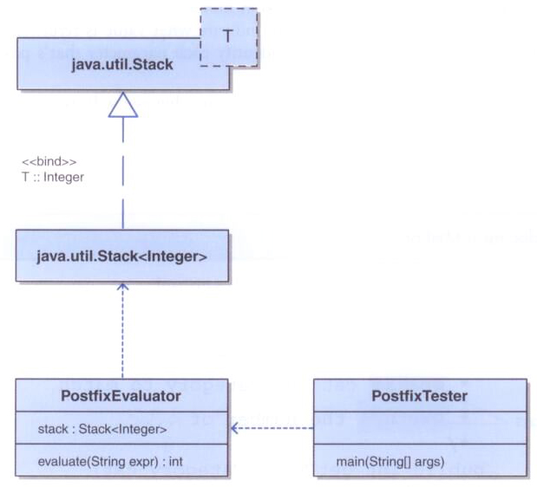
Postfix Evaluator UML

Slide 34
Javadoc
The documentation style used in the postfix example is called Javadoc
Javadoc comments are written in a format that allow a tool to parse the comments and extract key information
A Javadoc tool is used to create online documentation in HTML about a set of classes
The Java API documentation is generated in this way

Slide 35
Javadoc
Javadoc comments begin with /** and end with */
Specific Javadoc tags, which begin with a @, are used to identify particular information
Examples of Javadoc tags:
@author
@version
@param
@return

Slide 36
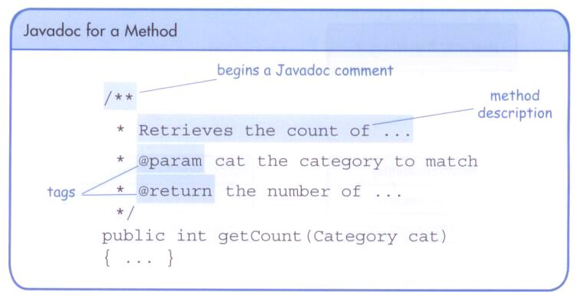
Javadoc

Slide 37
Exceptions
When should exceptions be thrown from a collection class?
Only when a problem is specific to the concept of the collection (not its implementation or its use)
There's no need for the user of a collection to worry about it getting "full," so we'll take care of any such limitations internally
But a stack should throw an exception if the user attempts to pop an empty stack

Slide 38
A Stack Interface
Although the API version of a stack did not rely on a formal interface, we will define one for our own version
To distinguish them, our collection interface names will have ADT (abstract data type) attached
Furthermore, our collection classes and interfaces will be defined as part of a package called jsjf

Slide 39
Stack Interface - Java

Slide 40
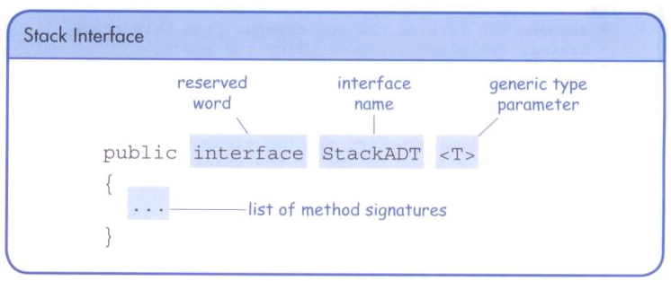
package jsjf;
/**
* Defines the interface to a stack collection.
*
* @author Lewis and Chase
* @version 4.0
*/
public interface StackADT<T>
{
/**
* Adds the specified element to the top of this stack.
* @param element element to be pushed onto the stack
*/
public void push(T element);
/**
* Removes and returns the top element from this stack.
* @return the element removed from the stack
*/
public T pop();
/**
* Returns without removing the top element of this stack.
* @return the element on top of the stack
*/
public T peek();
/**
* Returns true if this stack contains no elements.
* @return true if the stack is empty
*/
public boolean isEmpty();
/**
* Returns the number of elements in this stack.
* @return the number of elements in the stack
*/
public int size();
/**
* Returns a string representation of this stack.
* @return a string representation of the stack
*/
public String toString();
}

Slide 41
Stack Interface – C++

Slide 42
StackADT.h
#ifndef _STACKADT_H_
#define _STACKADT_H_
#include <string>
template <class T>
class StackADT
{
public:
virtual void push(T element) = 0;
virtual T pop() = 0;
virtual T peek() = 0;
virtual bool isEmpty() = 0;
virtual int size() = 0;
virtual std::string toString() = 0;
};
#endif

Slide 43
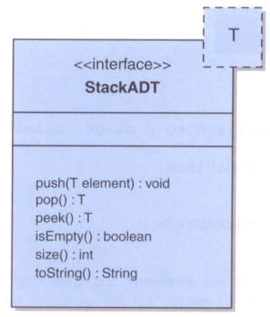
A Stack Interface

Slide 44
Implementing a Stack with an Array
Let's now explore our own implementation of a stack, using an array as the underlying structure in which we'll store the stack elements
We'll have to take into account the possibility that the array could become full
And remember that an array of objects really stores references to those objects

Slide 45
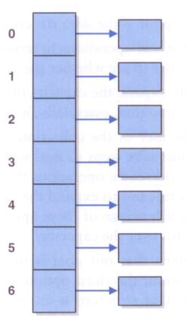
Implementing Stacks with an Array
An array of object references:

Slide 46
Managing Capacity
The number of cells in an array is called its capacity
It's not possible to change the capacity of an array in Java once it's been created
Therefore, to expand the capacity of the stack, we'll create a new (larger) array and copy over the elements
This will happen infrequently, and the user of the stack need not worry about it happening

Slide 47
Implementing Stacks with an Array
By convention, collection class names indicate the underlying structure
So ours will be called ArrayStack
java.util.Stack is an exception to this convention
Our solution will keep the bottom of the stack fixed at index 0 of the array
A separate integer called top will indicate where the top of the stack is, as well as how many elements are in the stack currently

Slide 48
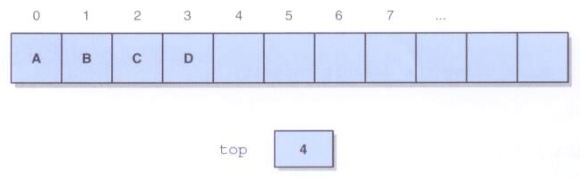
Implementing a Stack with an Array
A stack with elements A, B, C, and D pushed on in that order:

Slide 49
package jsjf;
import jsjf.exceptions.*;
import java.util.Arrays;
/**
* An array implementation of a stack in which the
* bottom of the stack is fixed at index 0.
*
* @author Lewis and Chase
* @version 4.0
*/
public class ArrayStack<T> implements StackADT<T>
{
private final static int DEFAULT_CAPACITY = 100;
private int top;
private T[] stack;

Slide 50
/**
* Creates an empty stack using the default capacity.
*/
public ArrayStack()
{
this(DEFAULT_CAPACITY);
}
/**
* Creates an empty stack using the specified capacity.
* @param initialCapacity the initial size of the array
*/
public ArrayStack(int initialCapacity)
{
top = 0;
stack = (T[])(new Object[initialCapacity]);
}

Slide 51
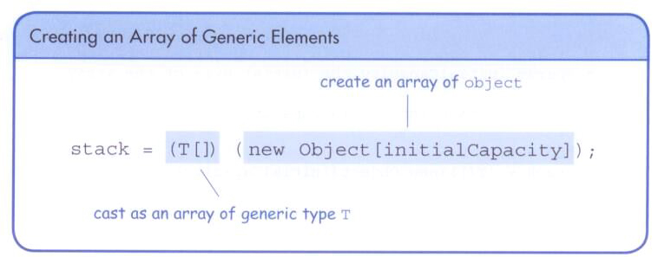
Creating an Array of a Generic Type
You cannot instantiate an array of a generic type directly
Instead, create an array of Object references and cast them to the generic type

Slide 52
/**
* Adds the specified element to the top of this stack, expanding
* the capacity of the array if necessary.
* @param element generic element to be pushed onto stack
*/
public void push(T element)
{
if (size() == stack.length)
expandCapacity();
stack[top] = element;
top++;
}
/**
* Creates a new array to store the contents of this stack with
* twice the capacity of the old one.
*/
private void expandCapacity()
{
stack = Arrays.copyOf(stack, stack.length * 2);
}

Slide 53
/**
* Removes the element at the top of this stack and returns a
* reference to it.
* @return element removed from top of stack
* @throws EmptyCollectionException if stack is empty
*/
public T pop() throws EmptyCollectionException
{
if (isEmpty())
throw new EmptyCollectionException("stack");
top--;
T result = stack[top];
stack[top] = null;
return result;
}
/**
* Returns a reference to the element at the top of this stack.
* The element is not removed from the stack.
* @return element on top of stack
* @throws EmptyCollectionException if stack is empty
*/
public T peek() throws EmptyCollectionException
{
if (isEmpty())
throw new EmptyCollectionException("stack");
return stack[top-1];
}

Slide 54
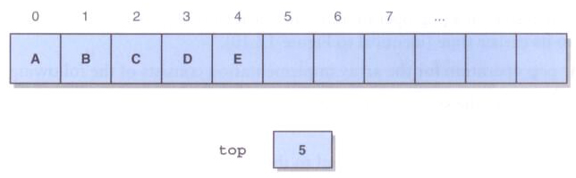
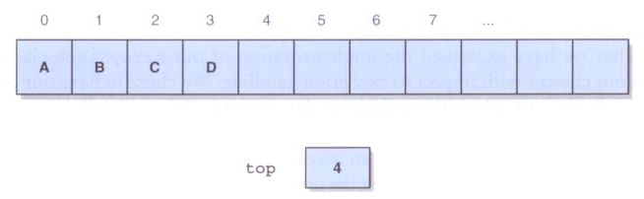
Pushing and Popping a Stack
After pushing element E:
After popping:

Slide 55
Defining an Exception
An EmptyCollectionException is thrown when a pop or a peek is attempted and the stack is empty
The EmptyCollectionException is defined to extend RuntimeException
By passing a string into its constructor, this exception can be used for other collections as well

Slide 56
package jsjf.exceptions;
/**
* Represents the situation in which a collection is empty.
*
* @author Lewis and Chase
* @version 4.0
*/
public class EmptyCollectionException extends RuntimeException
{
/**
* Sets up this exception with an appropriate message.
* @param collection the name of the collection
*/
public EmptyCollectionException(String collection)
{
super("The " + collection + " is empty.");
}
}

Slide 57
Stack implementation Array – C++

Slide 58
ArrayStack.h
#ifndef _ARRAYSTACK_H_
#define _ARRAYSTACK_H_
#include <string>
#include "StackADT.h"
#include "EmptyCollectionException.h"
/**
* An array implementation of a stack in which the bottom of the
* stack is fixed at index 0.
*
* @author Lewis and Chase
* @version 4.0
*/
template <class T>
class ArrayStack : public StackADT<T>
{
private:
static const int DEFAULT_CAPACITY = 100;
int top;
int capacity;
T* arrayStack;
/**
* Creates a new array to store the contents of this stack with
* twice the capacity of the old one.
*/
void expandCapacity()
{
T* tempStack = new T[capacity * 2];
for (int i = 0; i < top; i++)
tempStack[i] = arrayStack[i];
capacity *= 2;
delete[] arrayStack;
arrayStack = tempStack;
}

Slide 59
ArrayStack.h
public:
/**
* Creates an empty stack using the default capacity.
*/
ArrayStack() : ArrayStack(DEFAULT_CAPACITY) {}
/**
* Creates an empty stack using the specified capacity.
* @param initialCapacity the initial size of the array
*/
ArrayStack(int capacity)
{
top = 0;
this->capacity = capacity;
arrayStack = new T[capacity];
}
virtual ~ArrayStack()
{
if (arrayStack)
{
delete[] arrayStack;
}
}
/**
* Adds the specified element to the top of this stack, expanding
* the capacity of the array if necessary.
* @param element generic element to be pushed onto stack
*/
void push(T element)
{
if (size() == capacity)
expandCapacity();
arrayStack[top] = element;
top++;
}

Slide 60
ArrayStack.h
/**
* Removes the element at the top of this stack and returns a
* reference to it.
* @return element removed from top of stack
* @throws EmptyCollectionException if stack is empty
*/
T pop()
{
if (isEmpty())
throw EmptyCollectionException("stack");
top--;
T result = arrayStack[top];
return result;
}
/**
* Returns a reference to the element at the top of this stack.
* The element is not removed from the stack.
* @return element on top of stack
* @throws EmptyCollectionException if stack is empty
*/
T peek()
{
if (isEmpty())
throw EmptyCollectionException("stack");
return arrayStack[top - 1];
}
/**
* Returns true if this stack is empty and false otherwise.
* @return true if this stack is empty
*/
bool isEmpty()
{
// To be completed as a Programming Project
}

Slide 61
ArrayStack.h
/**
* Returns the number of elements in this stack.
* @return the number of elements in the stack
*/
int size()
{
// To be completed as a Programming Project
}
/**
* Returns a string representation of this stack.
* @return a string representation of the stack
*/
std::string toString()
{
// To be completed as a Programming Project
}
};
#endif // !_ARRAYSTACK_H_
EmptyCollectionException.h
#ifndef _EMPTYCOLLECTIONEXCEPTION_H_
#define _EMPTYCOLLECTIONEXCEPTION_H_
#include <stdexcept>
#include <string>
class EmptyCollectionException : public std::runtime_error
{
public:
EmptyCollectionException(std::string collection) : runtime_error(collection) {}
};
#endif // !_EMPTYCOLLECTIONEXCEPTION_H_

